Slide 1
Speech Denoising

Slide 2
Content
Problem description ( Noise introduction)
Data preprocessing (Sampling, STFT)
Deep complex Unet model (Introduction)
Dataset (Clean file and Noisy file)
Experiment

Slide 3
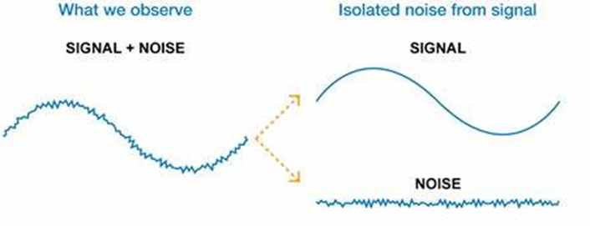
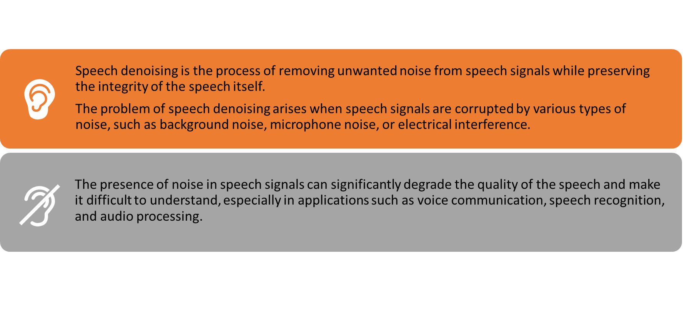
Problem description

Slide 4
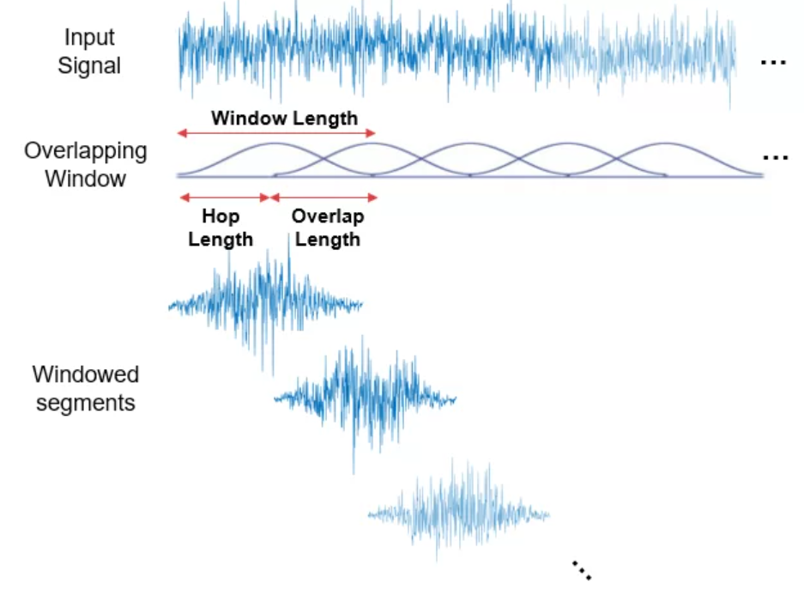
Data preprocessing
Input signal: F sampling = 48khz
Overlapping Window = 16
Hop length =

Slide 5
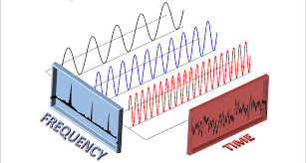
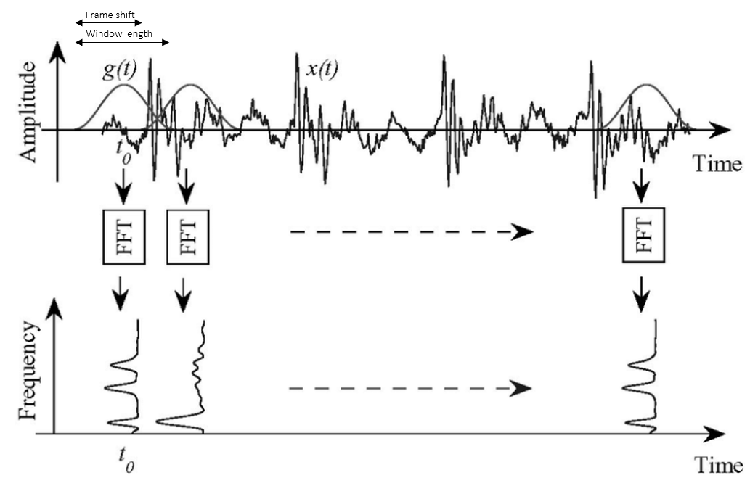
Short time fourier transform (STFT)

Slide 6
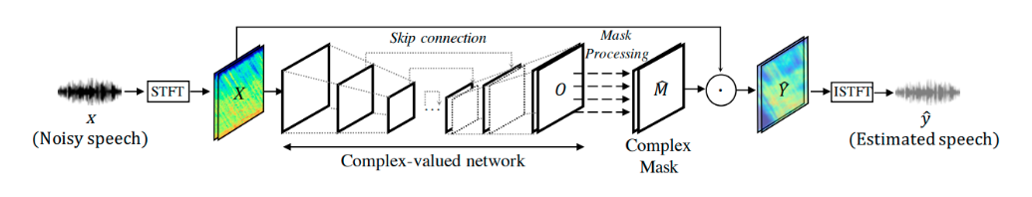

Slide 7
End

Slide 8
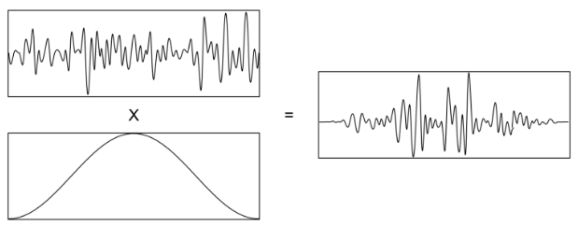
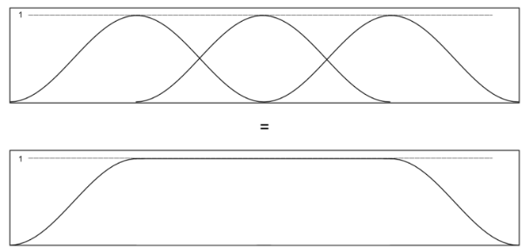
with an overlap factor of 50%, the sum of the windows is a constant value of 1
Multiplying by a half cosine function helps to fade the signal in and out so that the transitions at the edges do not affect the Fourier transform of the data.

Slide 9
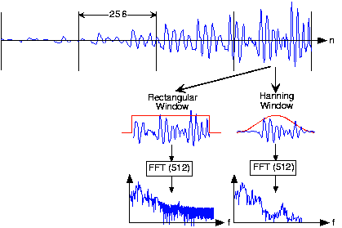
Why we need the hanning window?

